Slide 1
What
By Milton P. Jr. ☺ educationnow@yahoo.com.br

Slide 2
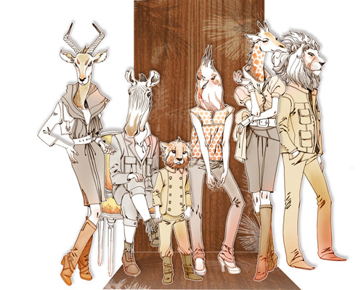
If you could be an animal, what animal would you be?

Slide 3
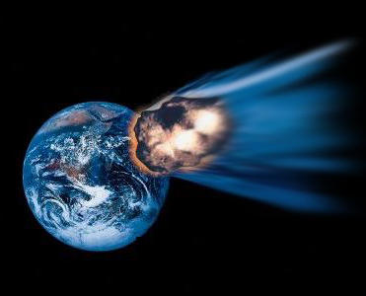
If you only had 24 hours to live, what would you do?
By Milton P. Jr. ☺ educationnow@yahoo.com.br

Slide 4
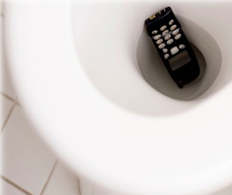
What if your smart-phone fell into the toilet, what would you do?

Slide 5
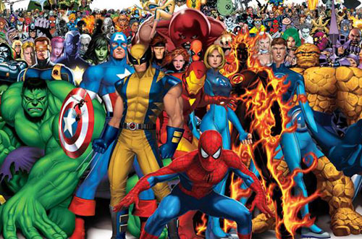
If you could be a super hero, which super hero would you be?

Slide 6
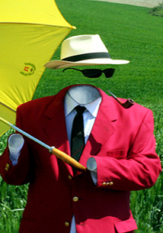
If you could be invisible for a day what would you do and why?
By Milton P. Jr. ☺ educationnow@yahoo.com.br

Slide 7
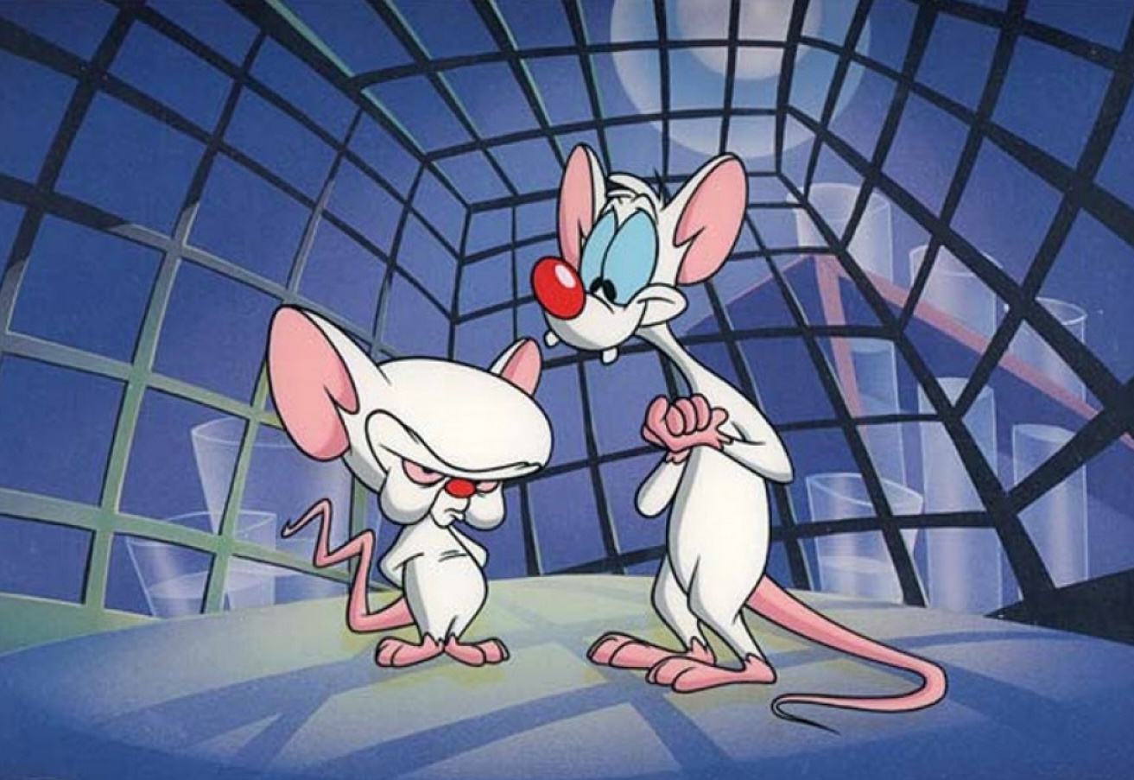
If you had to commit any crime, what would you do?

Slide 8
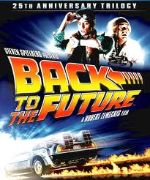
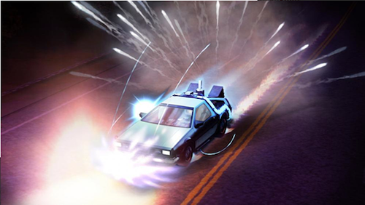
If there was a time machine and you could travel back in time, where and when would you go and why?

Slide 9
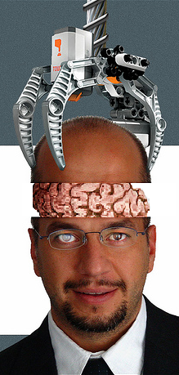
If you could be another man or woman for a day, who would you choose?
By Milton P. Jr. ☺ educationnow@yahoo.com.br

Slide 10
If you could change one thing about your country, what would it be?
By Milton P. Jr. ☺ educationnow@yahoo.com.br

Slide 11
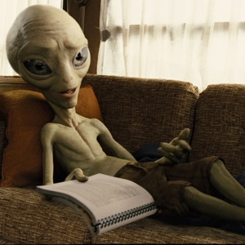
If you saw and photographed an alien, would you tell anybody?

Slide 12
If you could erase any moment in your life, which moment would it be and why?

Slide 13
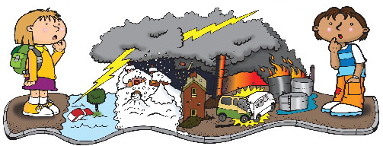
If you were experiencing a harsh moment in life, who would you go for help and why?

Slide 14
If you could sail around the world, who would you invite to go with you and why?

Slide 15
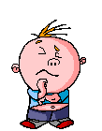
Think about one topic and ask a partner a question like this:
What WOULD you do if…
By Milton P. Jr. ☺ educationnow@yahoo.com.br

Slide 16
Good Job !
By Milton P. Jr. ☺ educationnow@yahoo.com.br

